Slide 1
PBHS 31001: Epidemiologic Methods 2023
Stata Session 2
(Slides are adopted from previous TA’s)

Slide 2
Topics to be discussed
1st Session (Univariate analysis) | 2nd Session (Bivariate analysis)
Primary orientation on STATA Access and open data sets (different formats, reshape) Explore variables (codebook, describe, label, sum, tab, tabstat, bysort) Create/Modify variables (gen, egen, replace, recode) | Chi-squared test and t-test in Stata Categorical variables Continuous variables Sub setting: if, and, or options (e.g., comparing means of groups) Missing data Graphing

Slide 3
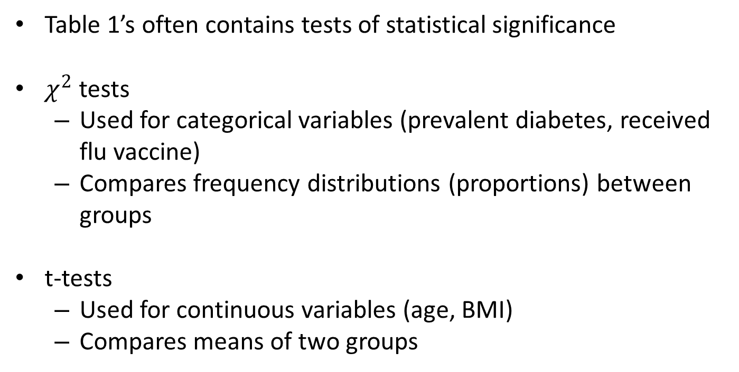
Hypothesis Testing

Slide 4
Categorical Variables: Hypothesis Testing
tab [var1] [var2], chi
Outputs a chi-squared test for the correct degree of freedom
For our purposes we are most interested in the p-value
. tab cursmoke sex if period==1, chi
current |
cig smoker | sex
y/n | 1 2 | Total
-----------+----------------------+----------
0 | 769 1,484 | 2,253
1 | 1,175 1,006 | 2,181
-----------+----------------------+----------
Total | 1,944 2,490 | 4,434
Pearson chi2(1) = 175.4299 Pr = 0.000
Notes:
Go to stata

Slide 5
Categorical Variables: Hypothesis Testing
We will not go into the statistics of how the chi squared is calculated
Takeaway: If certain conditions hold (e.g.: large “enough” sample size), the p-value gives a measure of how consistent the data are with what you would expect by chance (Statisticians may not like this explanation)
In a Table 1, we are often looking at whether measures (demographic, health, etc.) are different across categories of interest.
P value for chi-square test tells you how likely to observe a more extreme value than the one obtained, given the two variables are independent.
If smoking and gender were unrelated, you would expect a roughly equal distribution of gender for each cell of smoking.

Slide 6
Categorical Variables: Hypothesis Testing
Takeaway: Small p-value means that the distribution of [var1] is different for different values of [var2]
In the Stata example: men are more likely to be smokers than women, or the distribution of men and women by category of smoker is not the same.
In the context of your Table 1, if the chi-squared test comparing some trait across different populations has a p-value below some threshold (by convention 0.05), you would describe that trait as being statistically different across those populations.

Slide 7
Continuous Variables
E.g.: cholesterol, age, CD4 count
Most common way to summarize a continuous variable is by its mean
By extension, when comparing that variable across two populations, a reasonable question to ask is “do the means differ?”

Slide 8
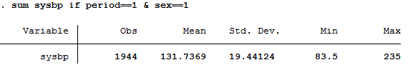
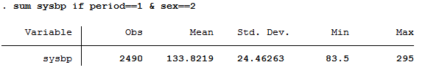
Continuous Variables: sum
sum sysbp if period==1 & sex==1
sum sysbp if period==1 & sex==2

Slide 9
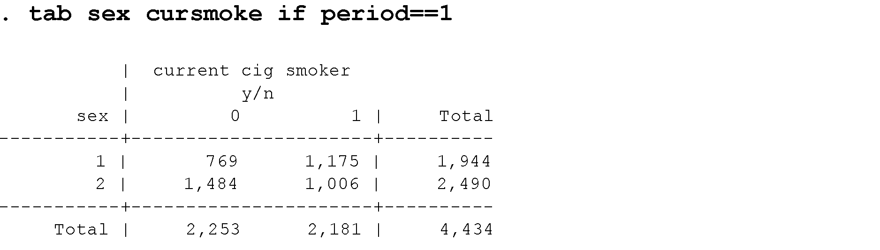
Analysis on subset of data: the “if” statement
tab [var1] [var2] if [condition], [options]
Quite general: can use in many commands, such as sum, reg, scatter
Almost always placed at the end of the command, but before any options (ie: before the comma)
tab sex cursmoke if period==1, missing
When specifying the condition, remember to use double “=“
Notes:
Go to stata

Slide 10
Continuous Variables: sum
sum [var] if [condition1] & [condition2]
and
sum [var] if [condition1] | [condition2]
or
Notes:
Go to stata

Slide 11
Continuous Variables: Hypothesis Testing
Blood pressure is “slightly” higher in women than in men
Can be more specific than “slightly,” in a statistically defensible way with t-tests
Equivalent to chi-squared in that a small p-value indicates that a difference in the means of the two groups is less likely due to chance alone.

Slide 12
Continuous Variables: Hypothesis Testing
ttest [ContVar], by([catVar])
Note the parentheses: the command will not work without them
. ttest sysbp if period==1, by (sex)
Two-sample t test with equal variances
------------------------------------------------------------------------------
Group | Obs Mean Std. Err. Std. Dev. [95% Conf. Interval]
---------+--------------------------------------------------------------------
1 | 1,944 131.7369 .4409362 19.44124 130.8721 132.6016
2 | 2,490 133.8219 .490234 24.46263 132.8606 134.7832
---------+--------------------------------------------------------------------
combined | 4,434 132.9078 .3367198 22.4216 132.2476 133.5679
---------+--------------------------------------------------------------------
diff | -2.085005 .6779578 -3.414141 -.755869
------------------------------------------------------------------------------
diff = mean(1) - mean(2) t = -3.0754
Ho: diff = 0 degrees of freedom = 4432
Ha: diff < 0 Ha: diff != 0 Ha: diff > 0
Pr(T < t) = 0.0011 Pr(|T| > |t|) = 0.0021 Pr(T > t) = 0.9989
Notes:
Go to stata

Slide 13
Not Necessary for the Homework, but Worth Knowing About
If you suspect that the variance of your continuous variable is different across categories (not just the mean), you can add the option “unequal”
ttest [ContVar], by([catVar]) unequal
If you want to test if the mean of a population is equal to a specific number
ttest [ContVar]==[value]

Slide 14
Missing Data
Knowing the data collection well enough to understand the process that resulted in missing data
Regardless, explore data for associations with missingness.
Missing data in outcome makes the observation useless.
Missing the primary exposure is almost as fatal, although there are solutions such as imputation.
*careful about missing data
tab stroke, missing
tab diabetes, missing
codebook bpmeds tab bpmeds, missing count if bpmeds==. | codebook totchol sum totchol mean totchol count if totchol==.

Slide 15
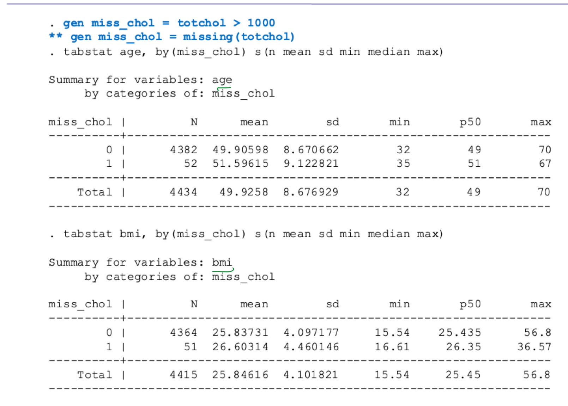
Missing Data

Slide 16
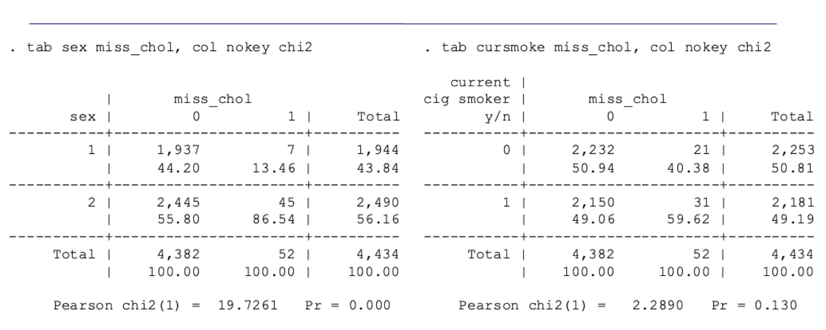
Missing Data

Slide 17
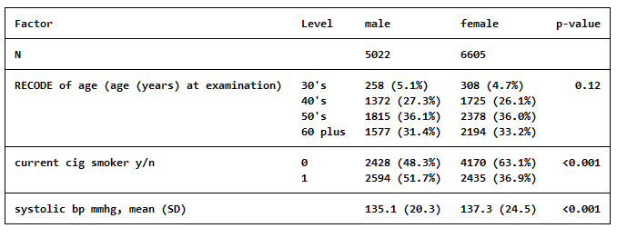
How to create simple table1
First Install package:
Code: ssc install table1
Code for table 1:
table1, by(sex) vars(ageCat cat\ cursmoke cat\ sysbp contn) format(%2.1f)
Code to save table in excel sheet:
table1, by(sex) vars(ageCat cat\ cursmoke cat) format(%2.1f) saving ("U:\Framingham_table1_2020.xls", replace)

Slide 18
Help table1
Table1, by(variable of interest) vars( covariate1 cat*/covariate2 contn*) format(%2.1f) missing⁺
Cat = categorical, groups compared using pearson’s chi-squared
Contn=continuoius, normally distributed
Conts = continuous, skey
Cate= categorical, groups compared using fisher’s exect test
Bin= binary groups compared using Pearson's chi-suqared
Bine=binary, groups compared using Fisher’s exact test

Slide 19
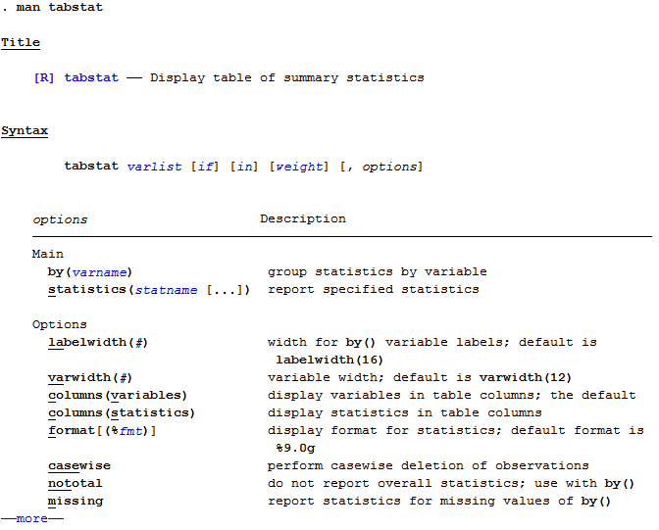
Help Command
Graphing Review
help [command name]

Slide 20
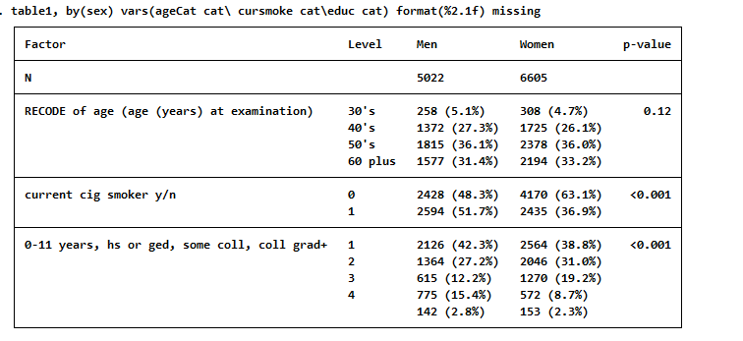
Table 1: looking at missing variables
table1, by(sex) vars(ageCat cat\ cursmoke cat\educ cat) format(%2.1f) missing
We see for education that there is a row for the missing variables, there are 142 missing for men and 153 missing for women. We don’t see this in the other variables because they don’t have missing data.

Slide 21
Graphing
Graphing Review
Stata is very useful for graphing out your analysis
Helps spot errors in recoding
Helps elucidate patterns
Documentation
The commands you will use for this course can almost all be extended to do very interesting things
If you are curious about these things, or need help figuring out how to use a command, Stata has documentation that is quite good
https://www.stata.com/support/faqs/graphics/gph/stata-graphs/
The syntax for these graphs is often quite complicated
May want to use the drop-down menus to build your graphs
If very unfamiliar with Stata, sometimes it’s OK to just use excel, or some other program you’re more comfortable with
Not great in practice: lots of opportunity for errors

Slide 22
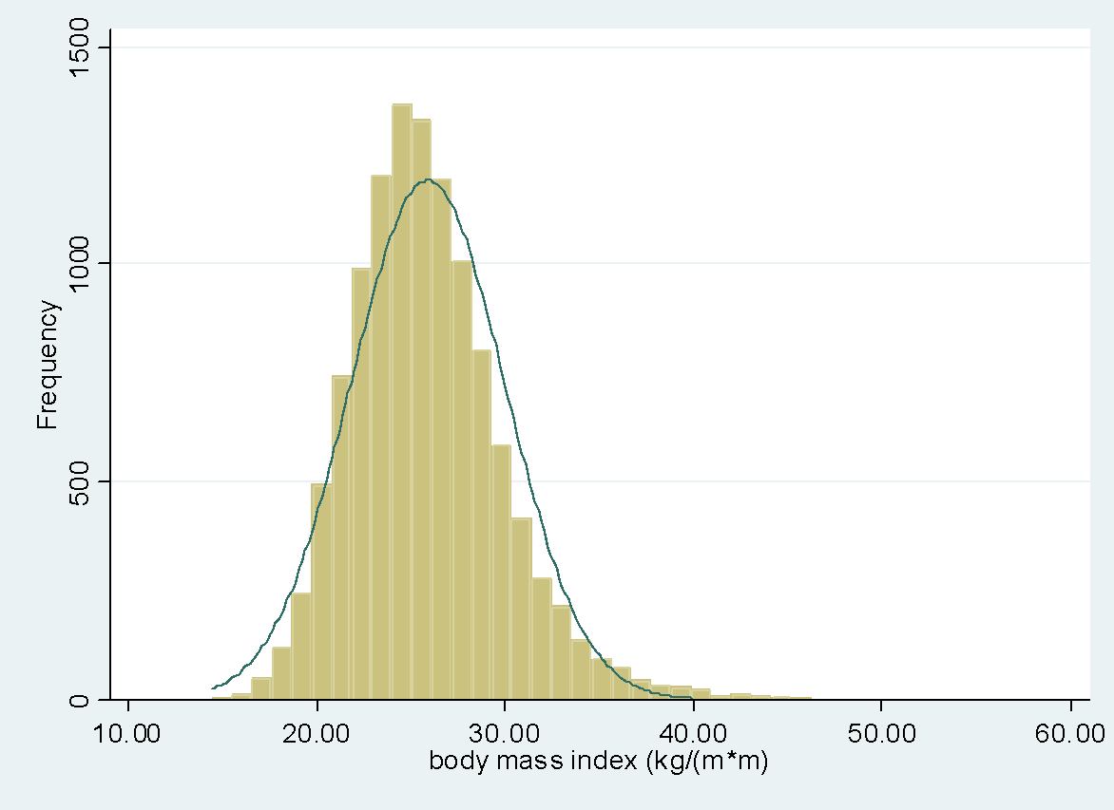
Histograms
Graphing Review
hist [varname]
Can follow with a comma, and options, such as overlaying a normal curve, labeling the axes, or using frequency instead of counts on the y axis
hist bmi, normal freq

Slide 23
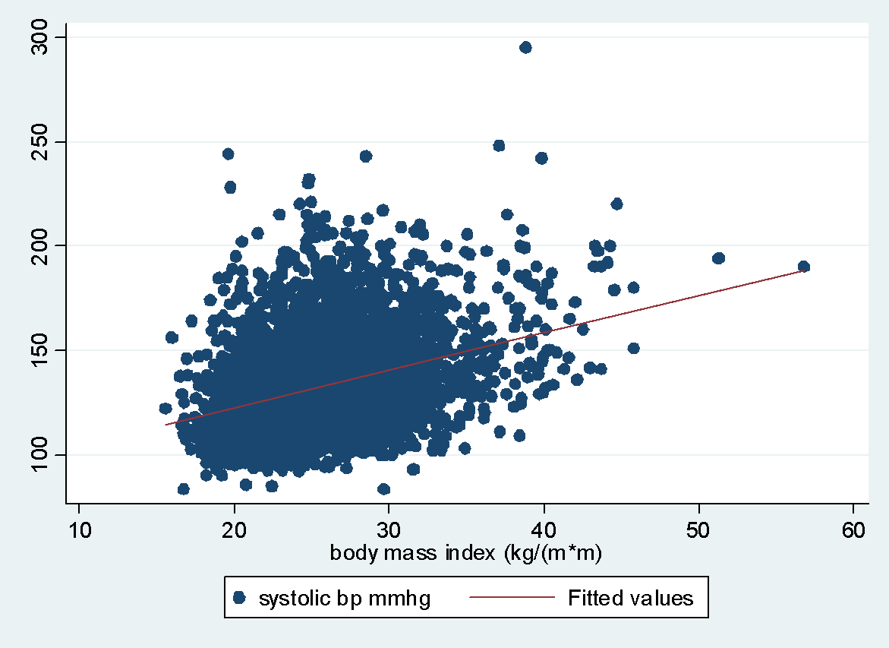
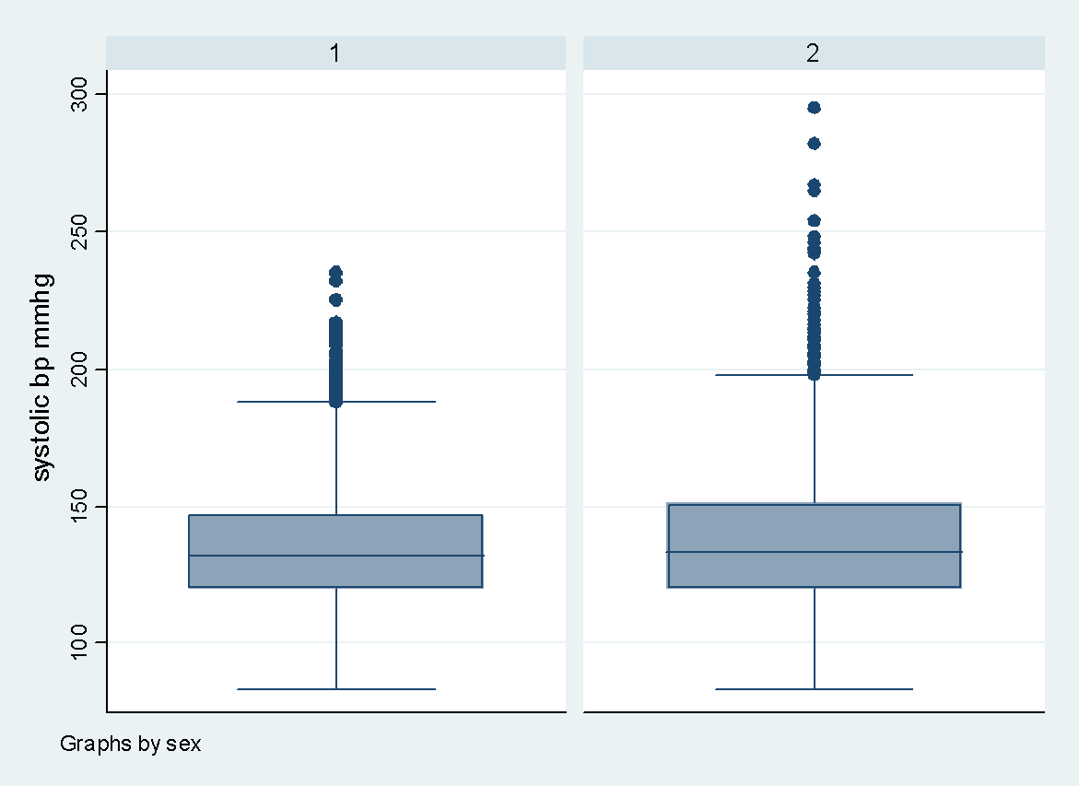
Scatter plot and Box plot
scatter sysbp bmi || (lfit sysbp bmi) if period==1
graph box sysbp, by(sex)

Slide 24
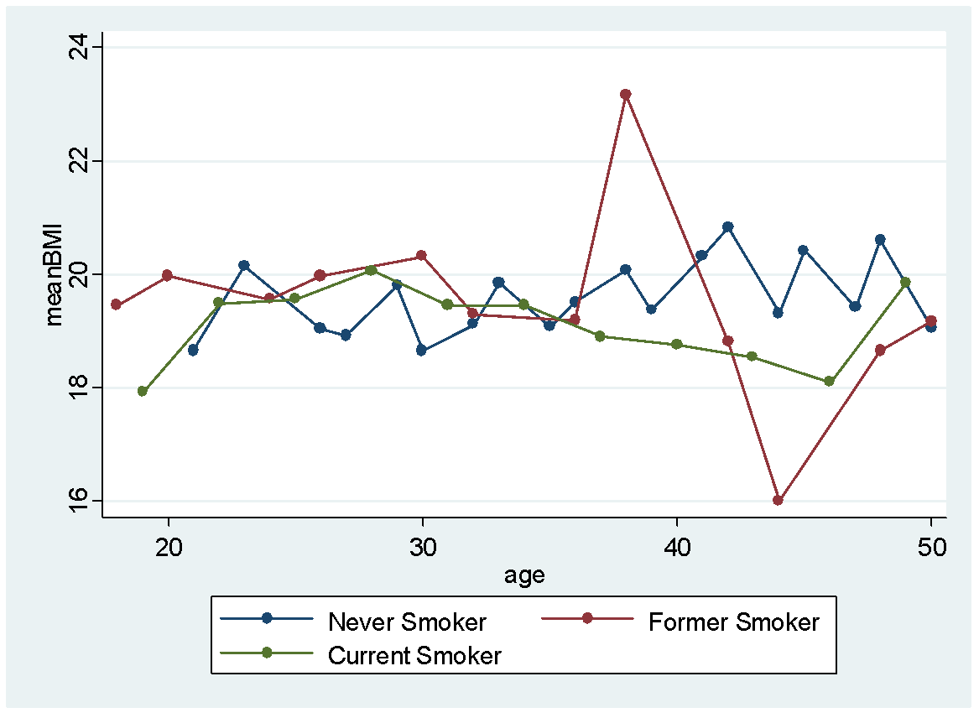
Graphing Trends, Stratified by Variable
Graphing Review
graph twoway scatter meanBMI age if smoker==0, connect(L) legend(label (1 "Never Smoker")) ///
|| scatter meanBMI age if smoker==1, connect(L) legend(label (2 "Former Smoker")) ///
|| scatter meanBMI age if smoker==2, connect(L) legend(label (3 "Current Smoker"))
Notes:
Need to generate variables meanBMI and smoker first

Slide 25
Graphing: Command Line
Graphing Review
Syntax:
graph twoway scatter [yVar] [xVar] if [subsetVar]==[condition1] ///
|| scatter [yVar] [xVar] if [subsetVar]==[condition2]
graph twoway scatter rate agegroup if cohort==1 connect(L) ///
|| scatter rate agegroup if cohort==2 connect(L)
Notes:
Go to stata – DH graph

Slide 26
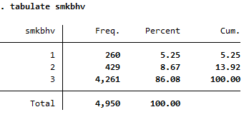
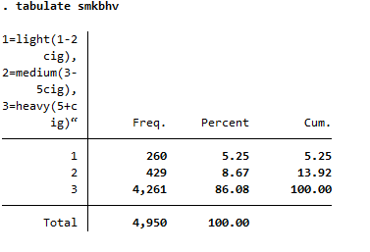
Creating/Modifying variables
gen smkbhv=.
replace smkbhv=1 if cigpday>=1 & cigpday<=2
replace smkbhv=2 if cigpday>=3 & cigpday<=5
replace smkbhv=3 if cigpday>5 & cigpday!=.
Label variable
label var smkbhv "1=light(1-2cig), 2=medium(3-5cig), 3=heavy(5+cig)“

Slide 27
Creating/Modifying variables
Sometimes you want to make categories of a variable (such as age)
If the variable you want to recode is numeric, this can be done easily using the recode statement, which combines a sequence of “generate,” “replace,” and “label” statements
recode [existingVariable] ([lowerbound1]/[upperbound1]= [recode1] “[label1]”) ([lowerbound2]/[upperbound2]= [recode2] “[label2]”)... ([lowerbound#]/[upperbound#]= [recode#] “[label#]”), gen([newVar])
recode age (min/39=0 "30's") (39/49=1 "40's") (49/59=2 "50's") (59/max=3 "60 plus") , gen(ageCat)
This will create a variable, ageCat, using the rules in the parentheses, and labeling it appropriately
Note that the “min” and “max” options avoid problems with missing data. With this code, if age is missing, then ageCat will be missing

Slide 28
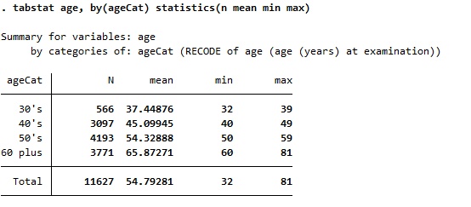
The tabstat command
tabstat[originalVariable], by([categoryVariable]) statistics(n mean min max)

Slide 29
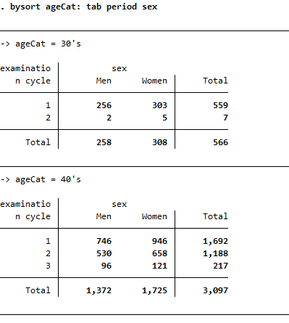
The “by” option
Graphing Review
The bysort option is quite useful to get results stratified by a variable
bysort [categoryVariable]: sum [originalVariable]
bysort ageCat: tab period sex
bysort can be replaced with just by if the data are already sorted by that variable

Slide 30
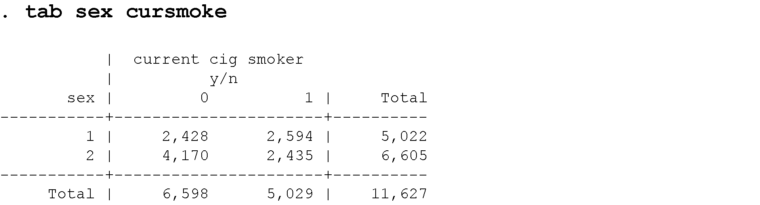
Categorical Variables
Review: the tab command
tab [varname]
tab [var1][var2]
tab [var1][var2], row
tab [var1][var2], col
tab [varname], missing
Notes:
Go to stata

